Slide 1
IMAGE CAPTIONING USING CNN-LSTM
Guide: submitted by:
Vaheetha salam Shifin.t.k(27)
vivek viswam(32)
Jincy joy(45)

Slide 2


OVERVIEW
INTRODUCTION
REQUIREMENTS
ARCHITECTURE
CNN AND LSTM
WORK FLOW
RESULT
REFERENCE

Slide 3
INTRODUCTION
Image caption generator is a task that involves computer vision and natural language processing concepts to recognize the context of an image and describe them in a natural language like English.
The objective of our project is to learn the concepts of a CNN and LSTM model and build a working model of Image caption generator by implementing CNN with LSTM.
This model can perform two operations.
The first one is to detect objects in the image using convolutional neural networks and the other is to caption the images using RNN based LSTM.

Slide 4
REQUIREMENTS
Prerequesties: tensorflow, keras, Pillow, numpy, tqdm
Dataset: Flicker8k_Dataset – Dataset folder which contains 8091 images.
Flickr_8k_text – Dataset folder which contains text files and captions of images.

Slide 5
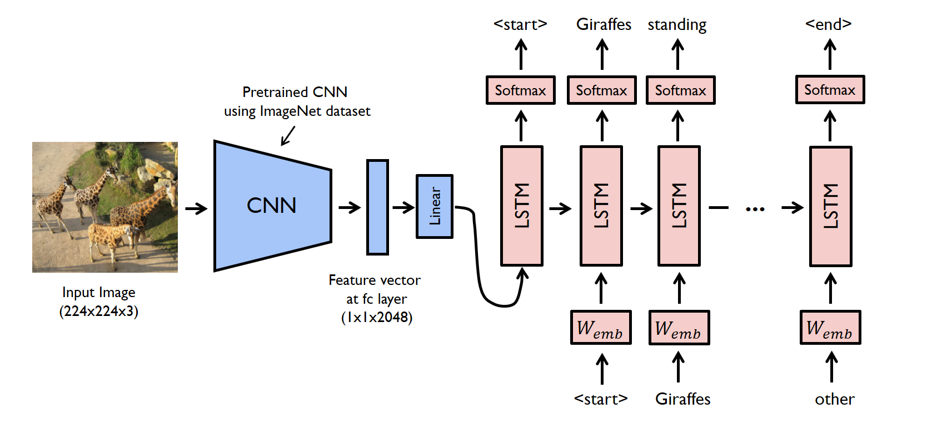
ARCHITECTURE

Slide 6
CNN(Convolutional Neural Network)
A CNN is a type of a neural network that is designed to process an image and represent it with a vector code. The architecture of CNN draws on fully-connected neural networks.
Convolutional Neural networks are specialized deep neural networks which can process the data that has input shape like a 2D matrix. Images are easily represented as a 2D matrix and CNN is very useful in working with images.
CNN is basically used for image classifications and identifying if an image is a bird, a plane or Superman, etc.

Slide 7
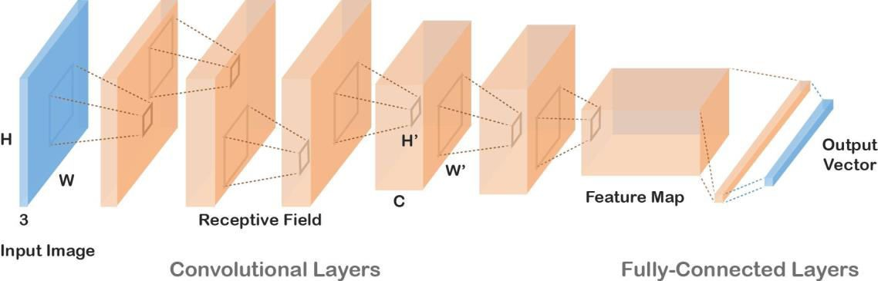
CNN ARCHITECTURE

Slide 8
LSTM
LSTM stands for Long short term memory, they are a type of RNN (recurrent neural network) which is well suited for sequence prediction problems.
It has proven itself effective from the traditional RNN by overcoming the limitations of RNN which had short term memory.
LSTM can carry out relevant information throughout the processing of inputs and with a forget gate, it discards non-relevant information.

Slide 9
WORKFLOW
(1) Import all necessary Packages:
Import all necessary packages needed for the project.
(2) Getting and performing DataCleaning:
We will define 5 functions:
load_doc( filename ) – For loading the document file and reading the contents inside the file into a string.
all_img_captions( filename ) – This function will create a descriptions dictionary that maps images with a list of 5 captions.
cleaning_text( descriptions) – This function takes all descriptions and performs data cleaning. In our case, we will be removing punctuations, converting all text to lowercase and removing words that contain numbers.

Slide 10
Continue….
text_vocabulary( descriptions ) – This is a simple function that will separate all the unique words and create the vocabulary from all the descriptions.
save_descriptions( descriptions, filename ) – This function will create a list of all the descriptions that have been preprocessed and store them into a file. We will create a descriptions.txt file to store all the captions.
(3) Extracting feature vector from all images:
The function extract_features() will extract features for all images and we will map image names with their respective feature array. Then we will dump the features dictionary into a “features.p” pickle file

Slide 11
Continue……
(4) Loading dataset for Training the model:
For loading the training dataset, we need more functions:
load_photos( filename ) – This will load the text file in a string and will return the list of image names.
load_clean_descriptions( filename, photos ) – This function will create a dictionary that contains captions for each photo from the list of photos. We also append the <start> and <end> identifier for each caption. We need this so that our LSTM model can identify the starting and ending of the caption.
load_features(photos) – This function will give us the dictionary for image names and their feature vector.
(5) Tokenizing the vocabulary
Computers don’t understand English words, for computers, we will have to represent them with numbers. So, we will map each word of the vocabulary with a unique index value.

Slide 12
Continue…..
load_features(photos) – This function will give us the dictionary for image names and their feature vector.
(5) Tokenizing the vocabulary
Computers don’t understand English words, for computers, we will have to represent them with numbers. So, we will map each word of the vocabulary with a unique index value.
Keras library provides us with the tokenizer function that we will use to create tokens from our vocabulary and save them to a “tokenizer.p” pickle file.
(6) Create Data generator:
The generator will yield the input and output sequence

Slide 13
Continue………..
(7) Training the model:
To train the model, we will be using the 6000 training images by generating the input and output sequences in batches and fitting them to the model using model.fit_generator() method. We also save the model to our models folder.
(8) Testing the model
testing_caption_generator.py which will load the model and generate predictions. The predictions contain the max length of index values so we will use the same tokenizer.p pickle file to get the words from their index values.

Slide 14
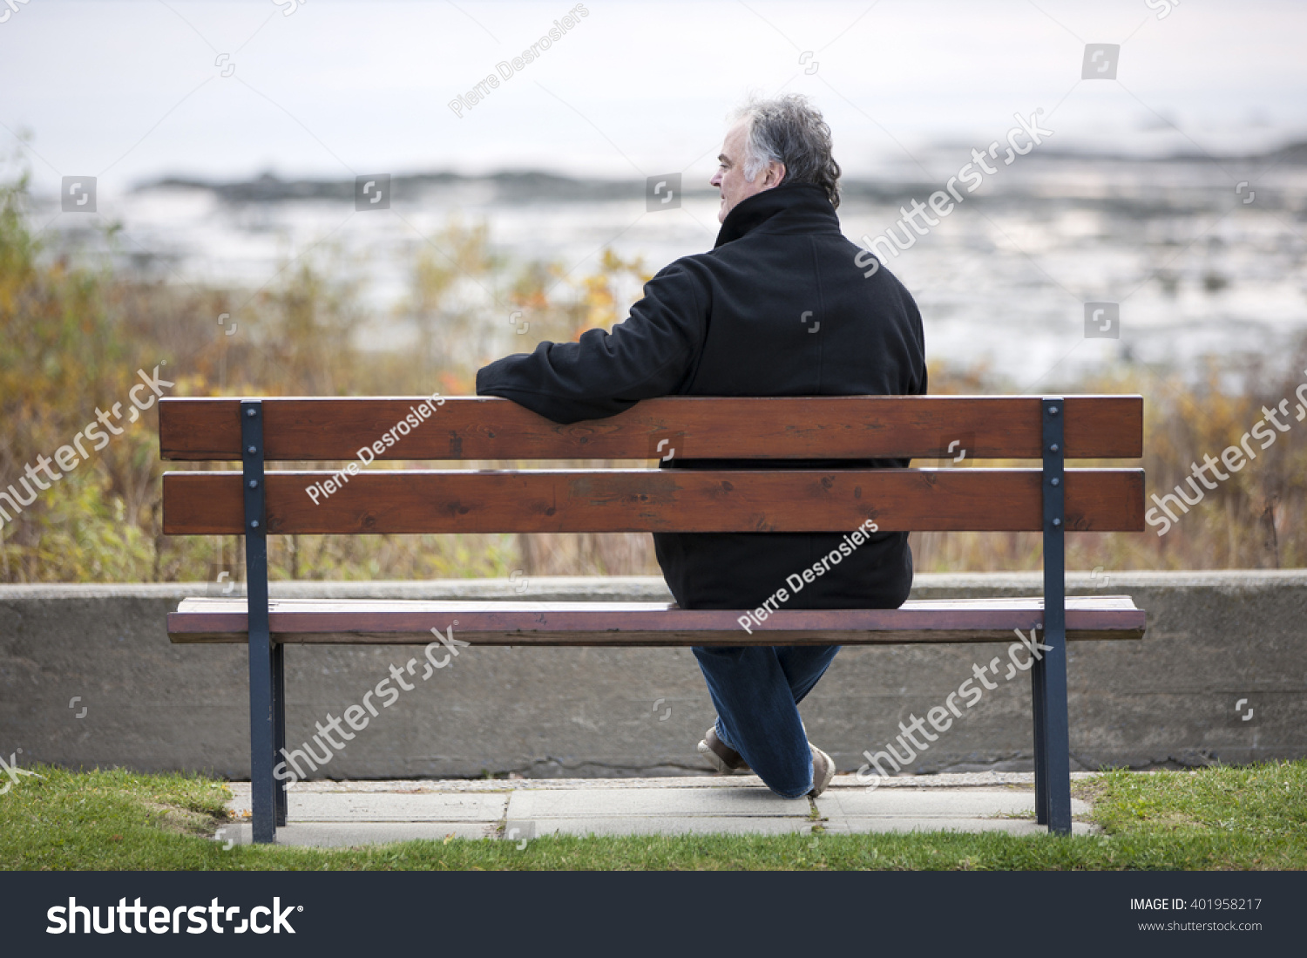
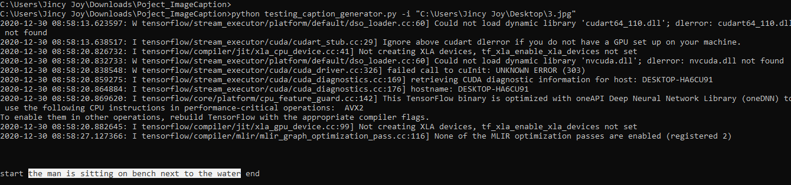
RESULT

Slide 15
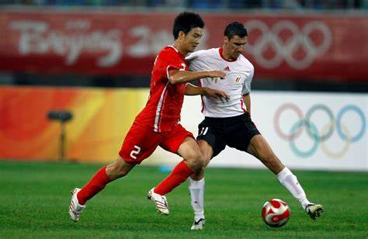
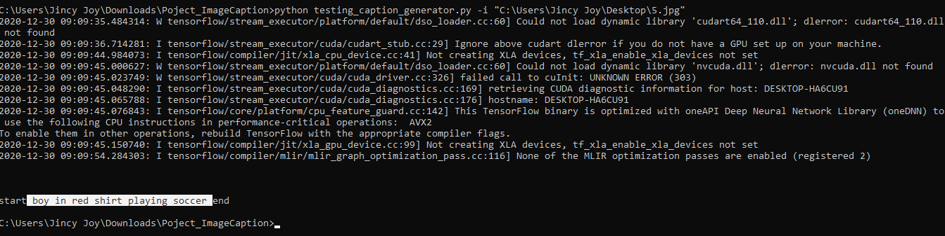
RESULT

Slide 16
REFERNCE
Image Caption Generation Using Deep Learning (IEEE 2018), (https://ieeexplore.ieee.org/document/8697360)
Deep image captioning using an ensemble of CNN and LSTM based deep neural networks - IOS Press

Slide 17
THANK YOU

